Slide 1
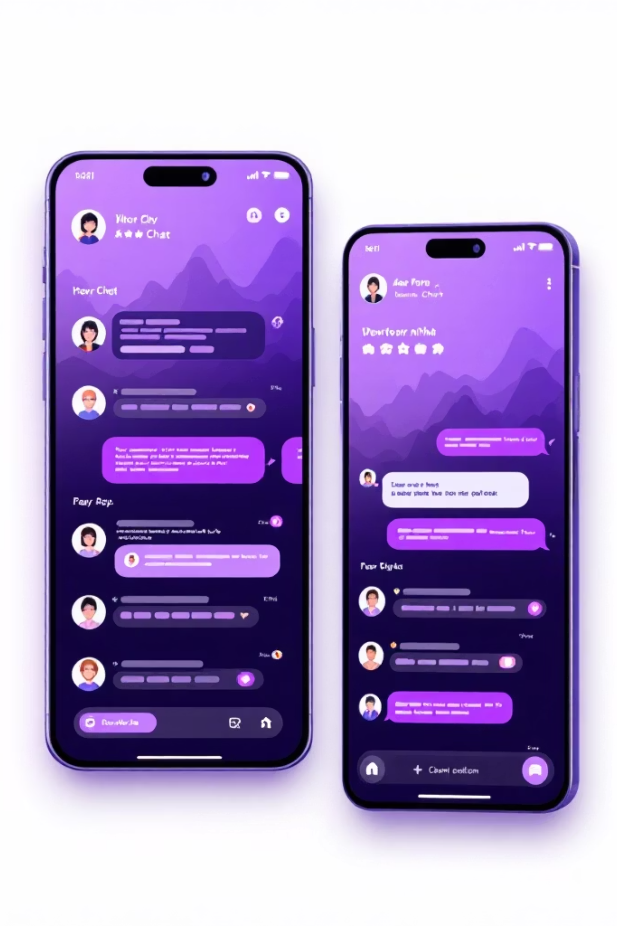
ChatterBox — Real‑Time WebSocket Chat Application
Full‑stack demonstration of instant messaging, moderation and persistence.
Presented by: Gopala Bhavya Sri Devi.

Slide 2
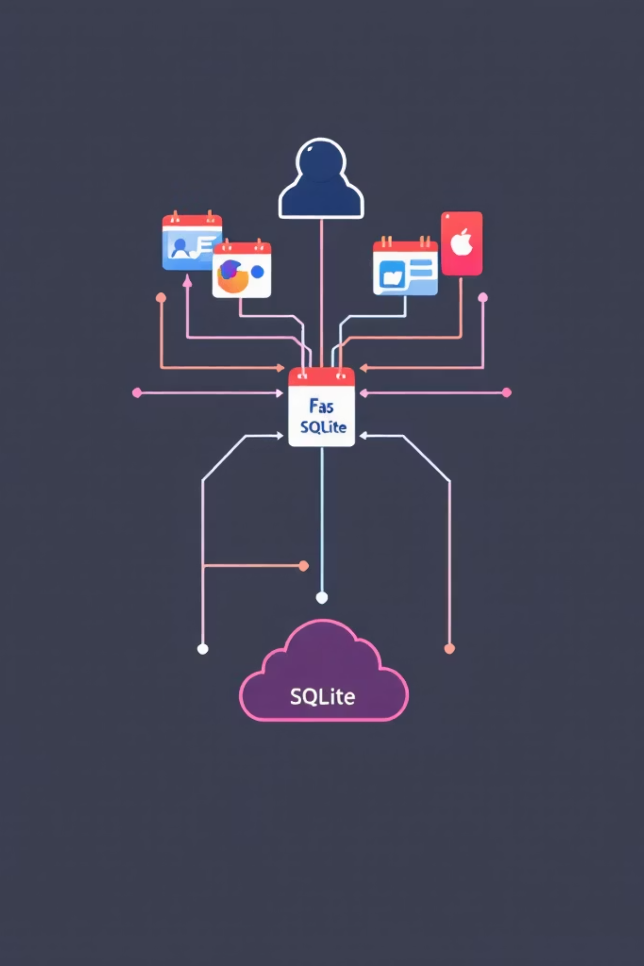
Project Overview
ChatterBox is a real‑time web chat built with FastAPI and WebSockets. It supports multi‑user chat, registration and login, message persistence, seen status, and a toxic‑word moderation workflow. The stack demonstrates end‑to‑end full‑stack integration.

Slide 3

Objectives
Real‑time Communication
Full duplex messaging with low latency via WebSockets.
Secure Authentication
Registration, login and cookie‑based session handling.
Data Persistence
SQLite stores messages, seen flags and user moderation state.
Moderation & UX
WhatsApp‑style seen feature plus toxic‑word detection and auto‑block.

Slide 4
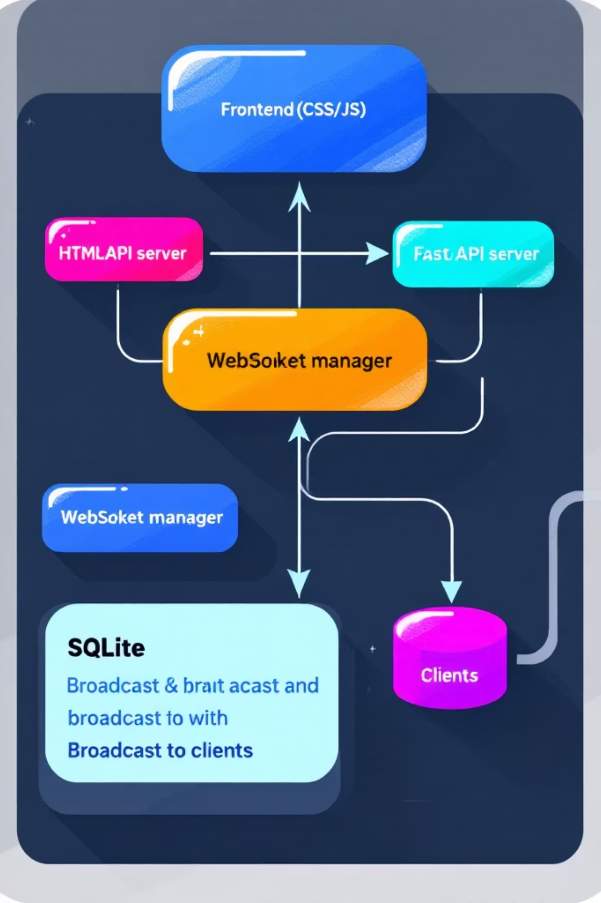
System Architecture
Client (browser) → WebSocket connection → FastAPI backend → SQLite persistence → Broadcast to active users. Frontend uses vanilla HTML, CSS and JavaScript for minimal dependency surface and predictable behaviour.

Slide 5
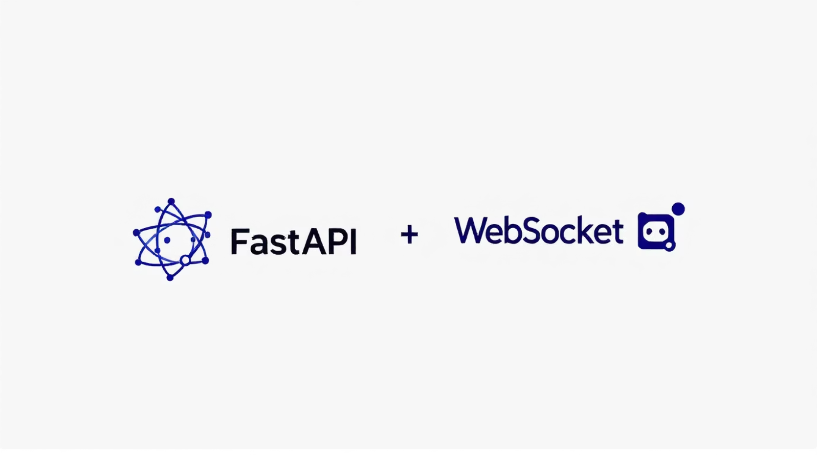
Technology Stack
Backend: FastAPI (Python), native WebSockets for bidirectional events.
Database: SQLite for lightweight, local persistence and simple schema.
Frontend: HTML5, CSS3, JavaScript with WebSocket API for real‑time UI updates.

Slide 6
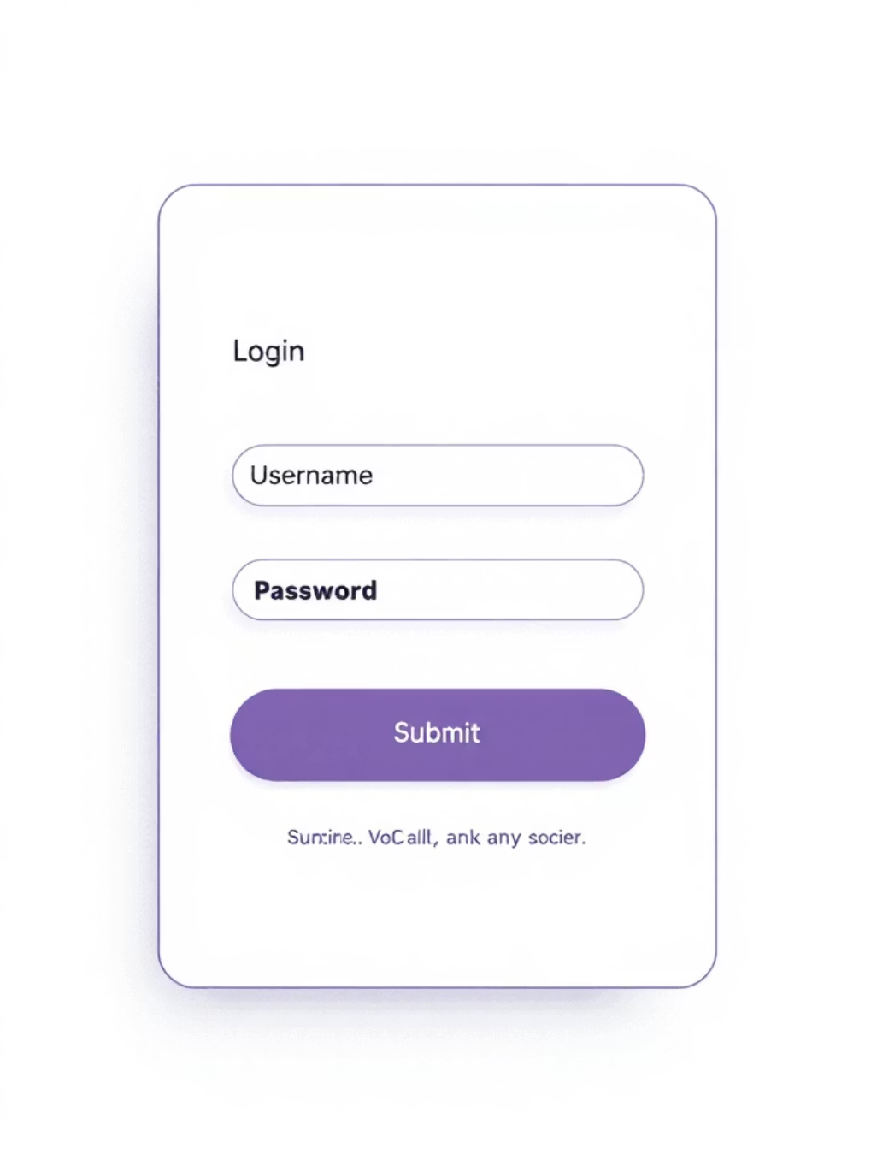
Authentication Module
Users register and log in; credentials are stored in the users table. Sessions use cookies to maintain authenticated WebSocket connections. The system tracks warnings and blocked state to prevent misbehaviour.
01
02
03
1. Register
2. Login
3. Access Control
Validate input and save hashed credentials.
Verify and issue session cookie; open WebSocket.
Blocked users are denied send permissions on socket events.

Slide 7
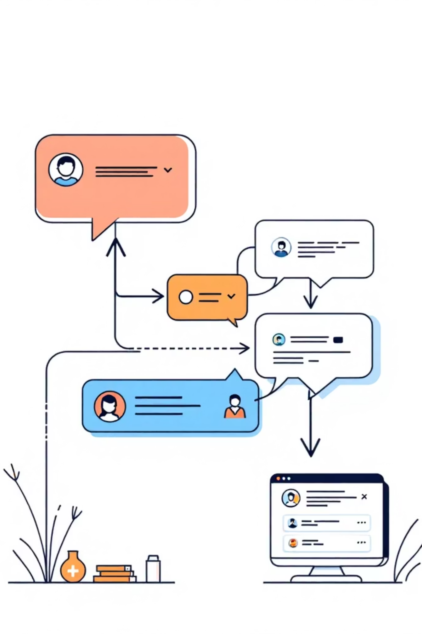

Real‑Time Chat Workflow
After login the client opens a WebSocket. Messages are sent as events to the server, written to SQLite, then broadcast to connected clients. The UI updates immediately without page refresh, ensuring smooth, low‑latency chat.
Send Message
Store Message
Broadcast
Update UI
The diagram highlights the core sequence ensuring atomic persistence and delivery to active users.

Slide 8

Seen Status Logic
Visual ticks indicate delivery and read state. Server updates the message 'seen' field when a recipient's client acknowledges the message. UI reflects:
Single tick: message sent or delivered but not read.
Double tick: recipient has opened the chat — database updated and sender notified.
If a recipient is offline or the tab is inactive, the tick remains single until an acknowledgment event is received.

Slide 9

Toxic‑Word Moderation
Messages are validated against a predefined stop‑word list before broadcast. Enforcement policy is incremental: first and second violations produce warnings; a third violation sets the user's blocked flag in the users table and prevents further sends.
Detection
Enforcement
Server‑side check on incoming messages to avoid client bypass.
Warnings increment a counter; three strikes → blocked.
UX Feedback
Users receive immediate warnings and an explicit blocked state message.

Slide 10


Data Model & Next Steps
Schema summary:
Users
Messages
username (PK), password (hashed), warnings, blocked
id, sender, message, timestamp, seen
Planned enhancements: group rooms, private chats, avatars, typing indicators and cloud deployment. Thank you.

Slide 11
Thank you

